Slide 1

INT 200 : HUMAN POSE ESTIMATION USING DEEP LEARNING TECHNIQUE
INT 200 Internship
First Review
Team Members
1. Daffney Christina (E0421032)
Project Guide:
Prof.B.Nirmala

Slide 2
Introduction
Human pose estimation (HPE), which has been extensively studied in computer vision literature, involves estimating the configuration of human body parts from input data captured by sensors, in particular images and videos.
HPE provides geometric and motion information of the human body which has been applied to a wide range of applications (e.g., human-computer interaction, motion analysis, augmented reality (AR), virtual reality (VR), healthcare, etc.).
With the rapid development of deep learning solutions in recent years, such solutions have been shown to outperform classical computer vision methods in various tasks including image classification, semantic segmentation and object detection.

Slide 3
Problem statement
DIABETES:
Diabetes is a condition which affects a person's metabolic system as the glucose level rises because of inadequate insulin production or due to the insufficient response of the body to insulin.
Symptoms: Hunger and fatigue, peeing more often and being thirstier, dry mouth and itchy skin, blurred vision.
Yoga is the best way to adjust your blood sugar levels to normal. Yoga keeps your stress level low, protects against cardiac diseases, prevents diabetic neuropathy, and boosts strength and balance to promote overall health.

Slide 4
Problem statement
Therapeutic Role of Yoga in Diabetes:
The key factors that increase the risk of Diabetes by 3 times are:
Unhealthy diet patterns
Lack of physical exercises
Psychological stress
Yoga is a set of activities that helps in controlling your stress, and emotions and helps in balancing the body to its perfect shape.

Slide 5
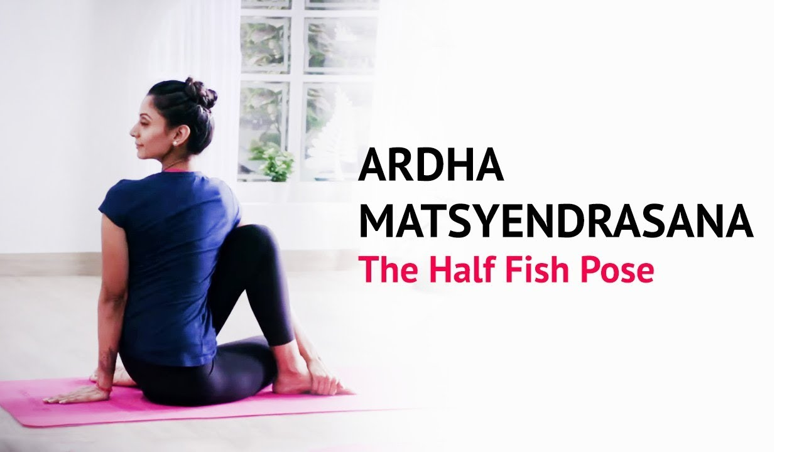
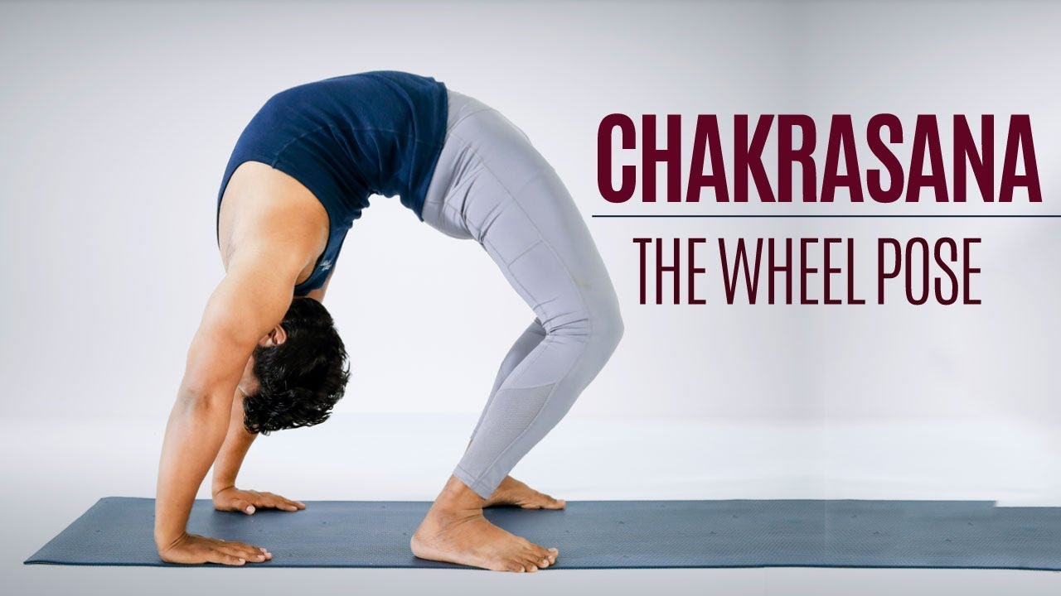
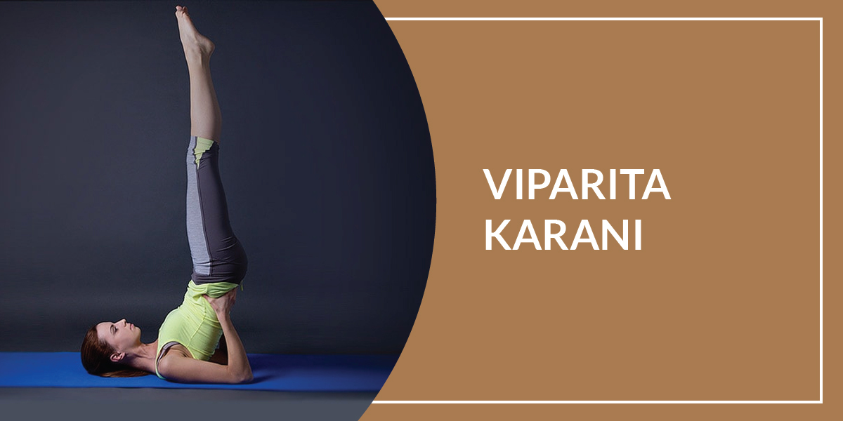
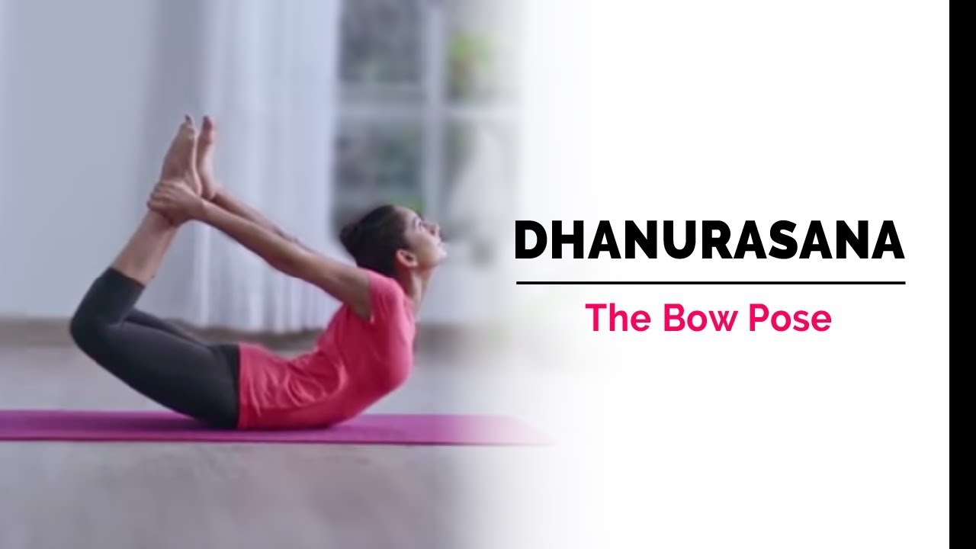
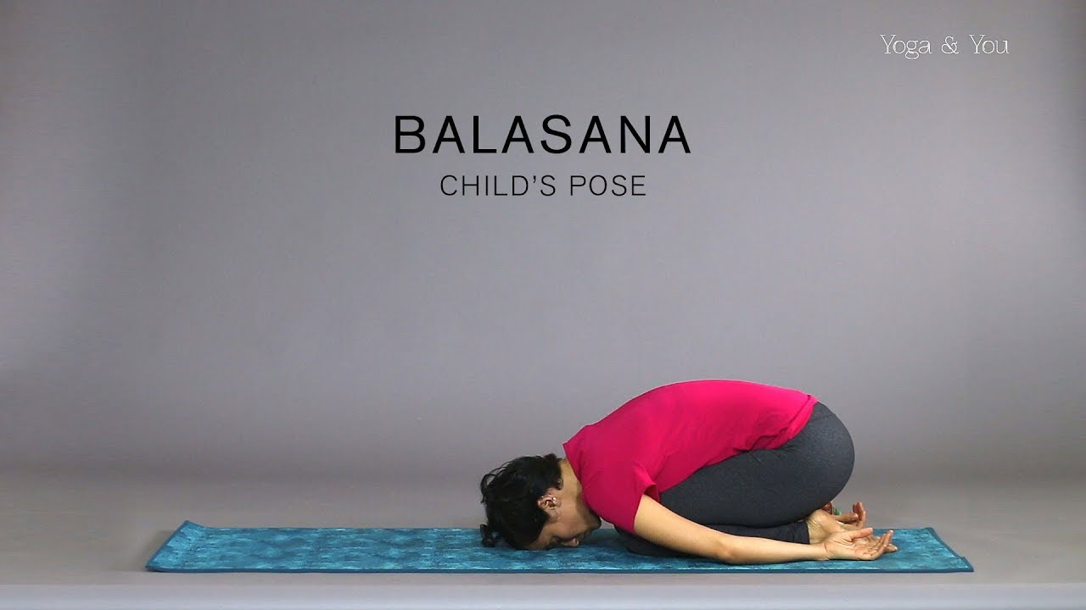
Problem statement
Some Yoga poses that helps curing Diabetes

Slide 6
Research
S.NO | TITLE | AUTHOR | YEAR | OVERVIEW
1 | Yoga Pose Classification using Deep Learning | Shruthi Kothari | 2020 | Model : SVM Accuracy : 0.9319
2 | Human Pose Estimation via Deep Neural Networks | Alexander Toshev, Christian Szegedy | 2014 | Model : SVM Accuracy : 0.9319

Slide 7
Work Flow
Data collection
Model
Data preparation
What data exists?
Where can you get it?
Is it structured or unstructured?
Exploratory data analysis(EDA)
Data preprocessing
Data splitting
Choose an algorithm
Over fit and regularize
Tune hyper parameters
Evaluation
Evaluation matrix
Serve Model
Put your model in production
Retrain Model
Are old productions still valid?
Feature importance and Training cost
Worst examples
Revaluate

Slide 8
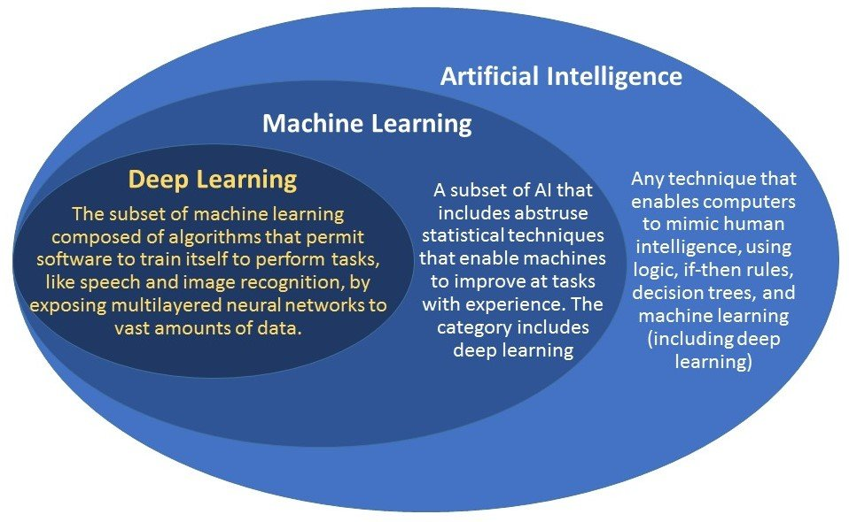
Work done
Flow chart of Artificial Intelligence, Machine Learning and Deep Learning

Slide 9

Work done
Machine Learning
GITHUB link:https://github.com/DaffneyChristina/Machine-learning

Slide 10
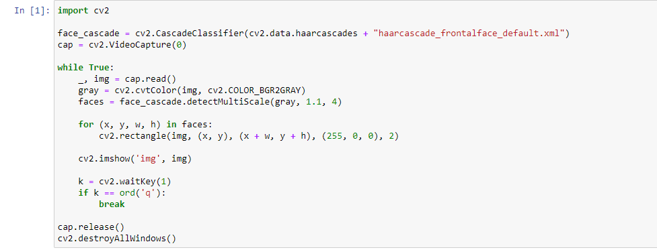
Work done
OPENCV – Code on face deduction using webcams
CODE:

Slide 11
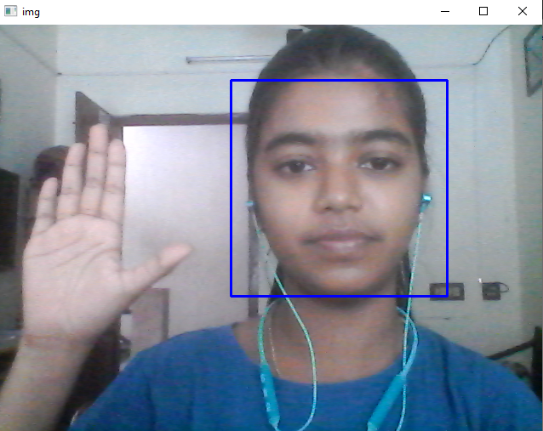
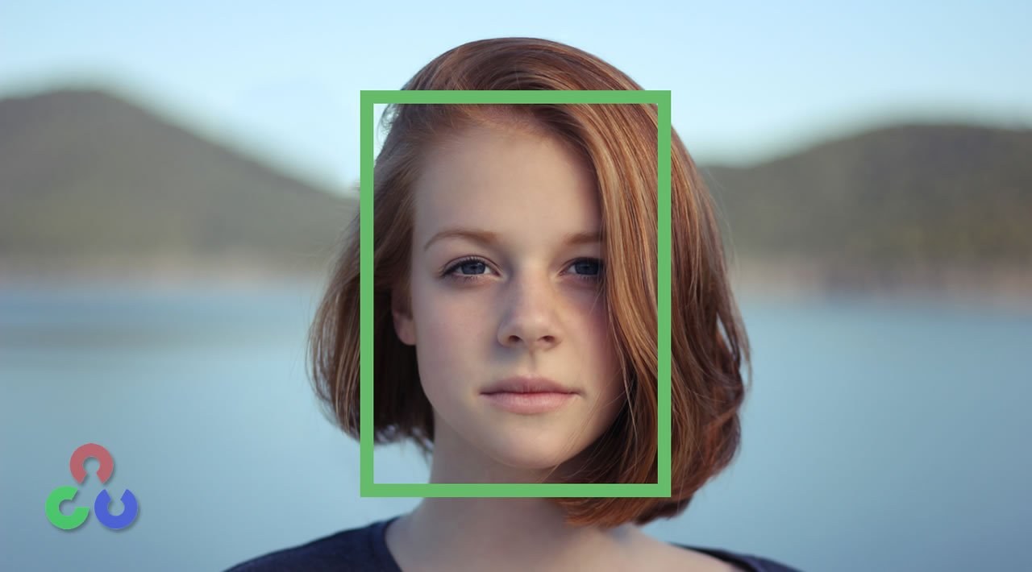
Work done

Slide 12
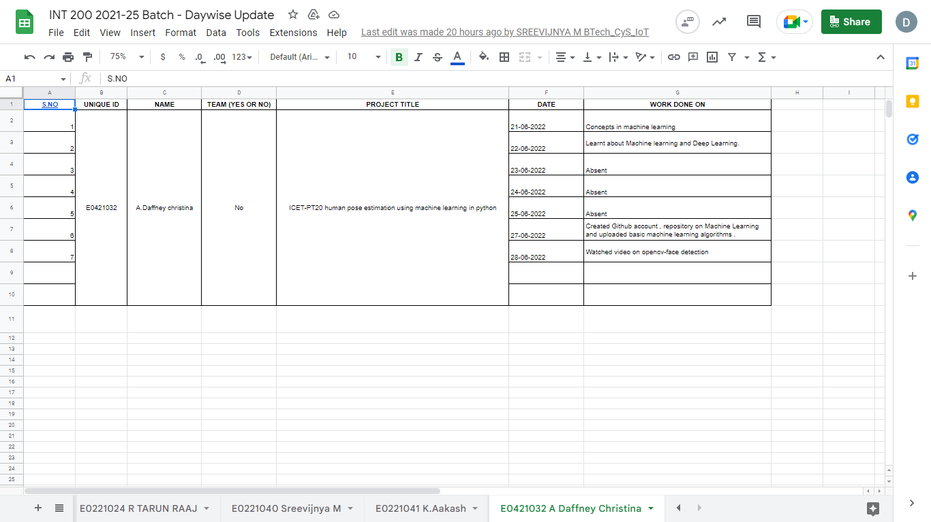
Timeline of the work

Slide 13
Reference
Websites
https://www.indiatoday.in/wellness/story/diseases-yoga-exercises-for-health-yoga-asana-medical-problems-curb-by-yoga-258533-2015-06-19
https://www.breathewellbeing.in/blog/best-yoga-asanas-for-diabetes-to-control-at-home-naturally/
https://www.mankindpharma.com/blog/benefits-of-yoga-and-8-diseases-it-can-cure
Videos
https://www.youtube.com/watch?v=-ZrDjwXZGxI
https://www.youtube.com/watch?v=T2ykss_4Af0&t=137s

Slide 14
Thank you

